Slide 1
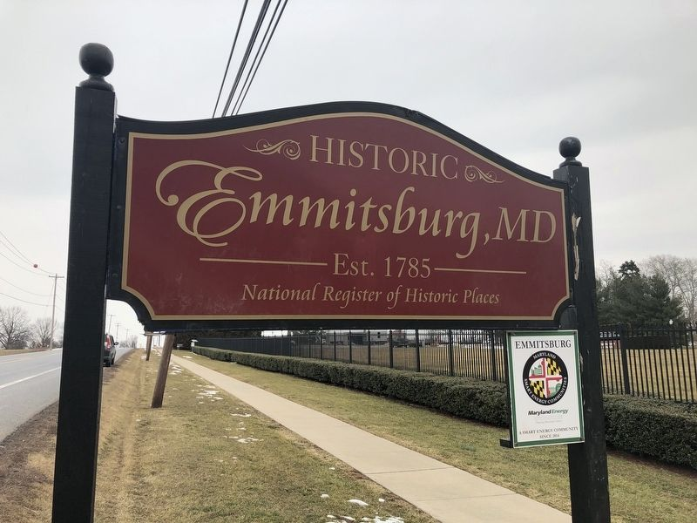
FRAILEY FARM
Proposed Annexation and Development of a Residential Community

Slide 2
Town of Emmitsburg Workshop Agenda October 24, 2022
INTRODUCTION & ENTITLEMENT PROCESS 3-4
MEET THE FRAILEY FARM TEAM 5
PRESENTATION OF THE CONCEPT PLAN 6-8
PROJECT BENEFITS & CHALLENGES 9

Slide 3
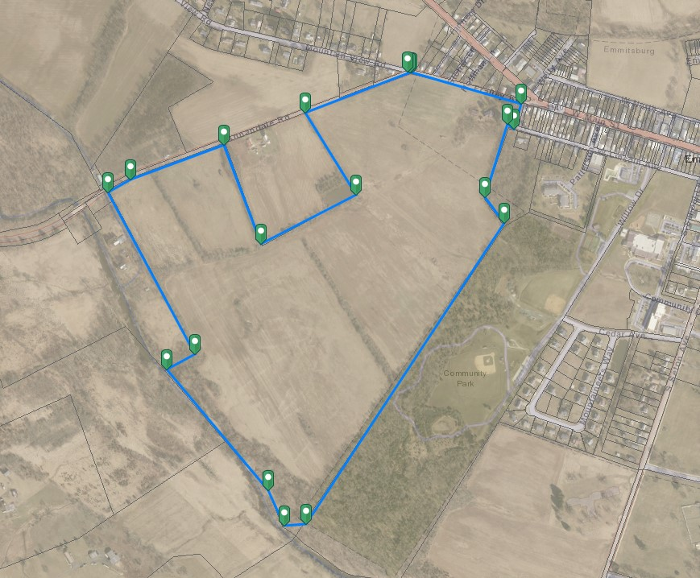
Introduction:
The Frailey Farm is a 118-acre farm currently identified by the Town of Emmitsburg’s 2015 Comprehensive Plan to be annexed for residential housing growth.

Slide 4
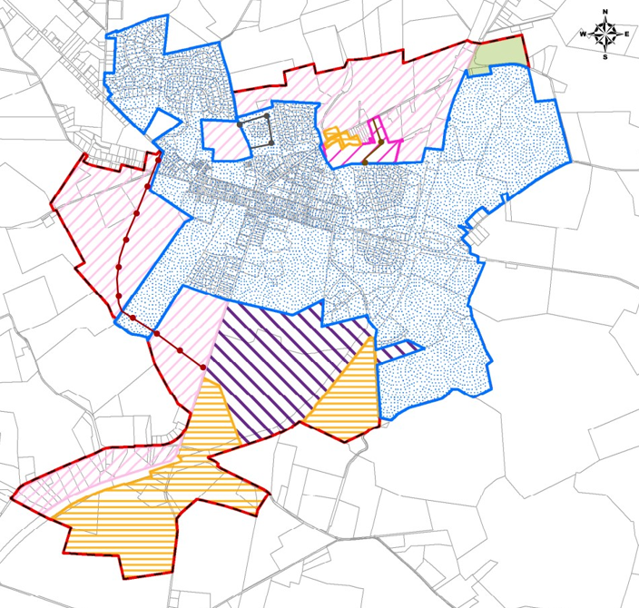
Annexation & Entitlement Process:
1. We will collaborate with the Mayor, Board of Commissioners, and Planning Commission regarding density, Product types, APFO issues, infrastructure improvements and any other items important to the Town.
2. We will use the 2015 comp plan’s stated goals as our guide.
3. We will listen to community and Town feedback to refine and improve the plan.
4. We will provide a state-of-the-art development that enhances the Town of Emmitsburg by implementing sustainable, smart growth community standards that provide connectivity to the historic downtown amenities.
2021 Town of Emmitsburg Growth Map and Suggested Land Use Designations

Slide 5
Meet the Frailey Farm Team
Development Team
Combined we have almost 100 years of development experience
Jeff Ott
Bob Brvenik
Tom Burnside
Legal/Land Use Team – McCurdy, Dean & Graditor, LLC
The experienced attorneys at McCurdy, Dean & Graditor, LLC pride themselves in having provided the Frederick Community with decades of comprehensive, client-focused and cost-effective legal representation.
Bruce Dean
Lisa Graditor
Engineering Team – Soltesz and Piedmont Design Group
Soltesz is a multi-disciplinary engineering firm experienced in navigating clients through each phase of a project to innovative, effective solutions. Our clients include developers, builders, property owners, public agencies, corporations, institutions, and energy companies around the greater Washington metropolitan area.
Piedmont Design Group Piedmont’s mission is to provide timely, cost-effective, personal service to our clients, by providing value-added, quality design and processing services for land development. Piedmont practices engineering and land surveying in the States of Maryland and West Virginia, and the Commonwealth’s of Virginia and Pennsylvania.
Mike Wiley
Phil Isaja
Daniel Park

Slide 6
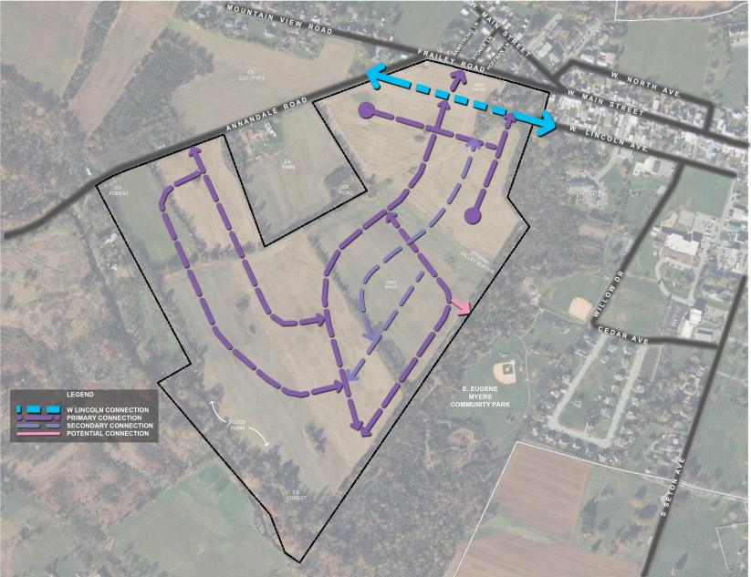
The Concept Plan – Vehicular Circulation

Slide 7
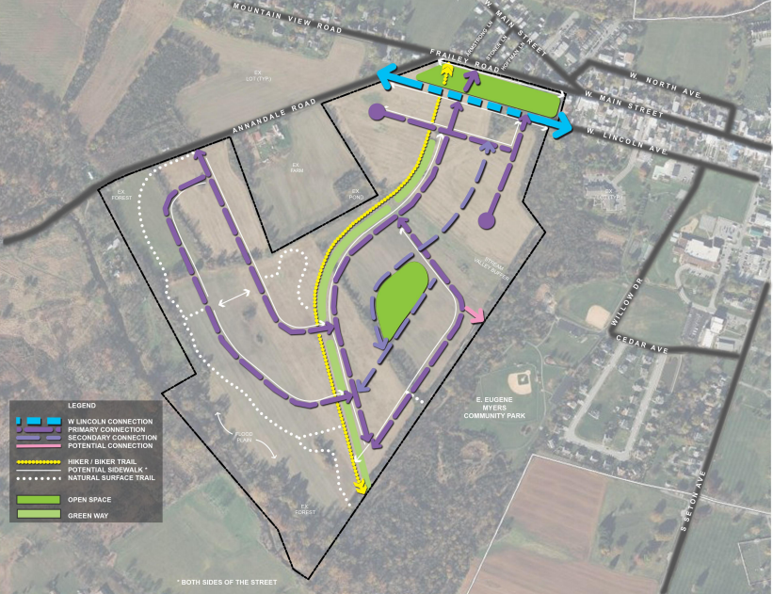
The Concept Plan – Trail & Sidewalk System with Green Spaces

Slide 8
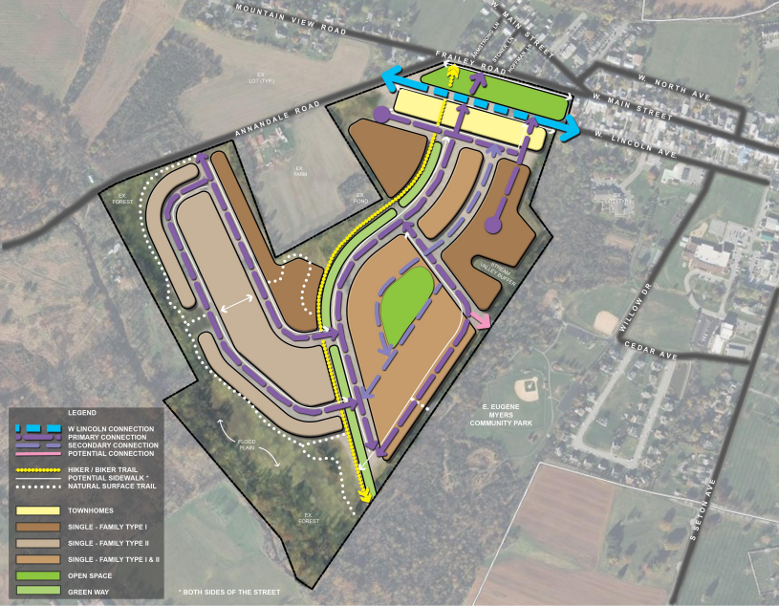
The Concept Plan – Land Use Diagram

Slide 9
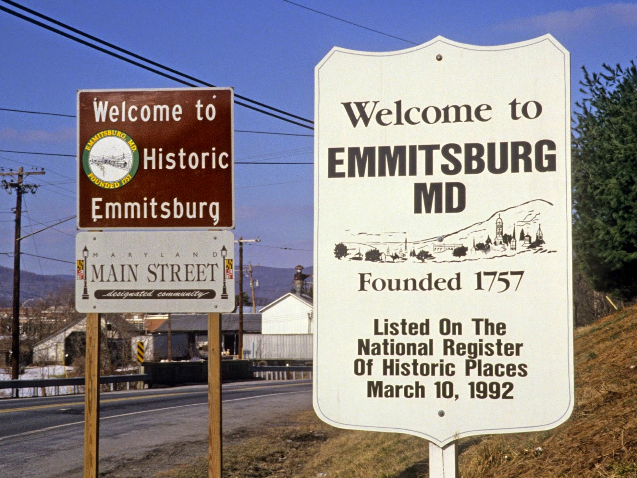
Frailey Farm Development Benefits:
Partner with the Town to achieve the Comp Plan goal of annexing the Frailey Farm into the town.
Help energize Main Street into a vibrant place for the entire community.
Opportunity to build a responsible smart growth neighborhood of varying housing types and price points.
Contribute to infrastructure improvements related to water, sewer, and traffic.

Slide 10
thank you!
Frailey Farm Development Team

